Slide 1


An Interactive 3D Virtual Anatomy Puzzle for Learning and Simulation — Initial Demonstration and Evaluation
Erik MESSIER ^{a,1}, Jascha WILCOX ª, Gabriel DIAZ ^{b}, and Cristian A. LINTE ^{a,b}
ªKate Gleason College of Engineering, ^{b}Chester F. Carlson Center for Imaging Science, Rochester Institute of Technology, Rochester, NY, USA
2016 Medicine Meets Virtual Reality
Las Angeles CA USA

Slide 2
Why a 3D Virtual Anatomy Puzzle Game?
Anatomy is implicitly 3D, yet ubiquitously taught in 2D.
We live in an era where 3D, 4D , and 5D medical images are abundant.
The availability and cost of ownership of 3D display hardware has vastly improved in the past decade.

Slide 3
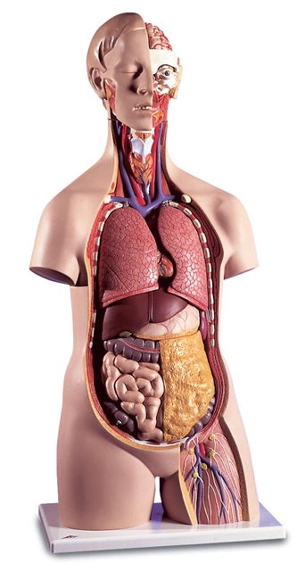
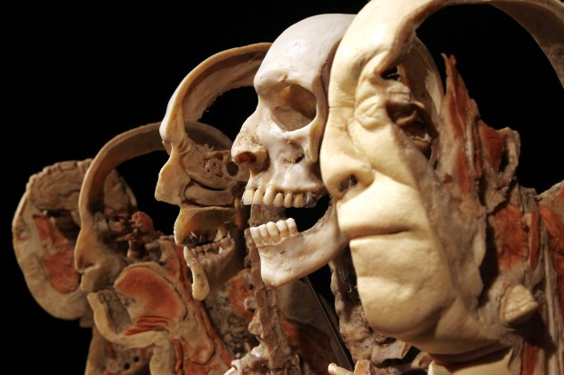
Anatomy is Implicitly 3D
Conventional 3D didactic tools are limited, are generally costly, and/or require appropriate infrastructure.
2016 STLtoday.com
3B Scientific 2016 c
Notes:
Image from 2016 body world exhibit in St. Louis. Pictured is the “Sagittal 3D Slice Body”.

Slide 4
Abundant 3D, 4D, and 5D Medical Data and Software
Datasets:
Visible Human Project
BodyParts3D
ZygoteBodyTM Dataset
Software:
Mimics
3DSlicer
Notes:
OsiriX is an open source program for viewing medical datasets such as CT and MRI scans, and it is possible to extract 3D structures in a format that can be used for engineering.
Mimics: Mimics is an image processing software for 3D design and modeling, developed by Materialise NV.

Slide 5
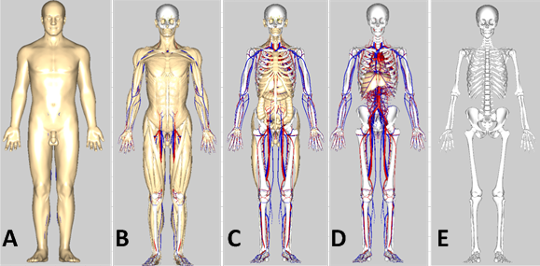
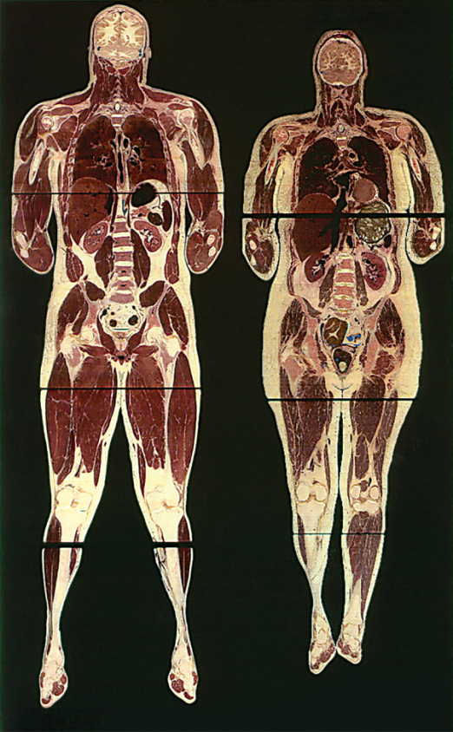
Abundant 3D, 4D, and 5D Medical Images
BodyParts3D
National Library of Medicine
Notes:
The visible human: Computed Tomography (CT), Magnetic resonance Imaging (MRI), as well as digital histology slices. Can produce 3D models through manual or automatic segmentation techniques, or volume rendered segmentation techniques.

Slide 6
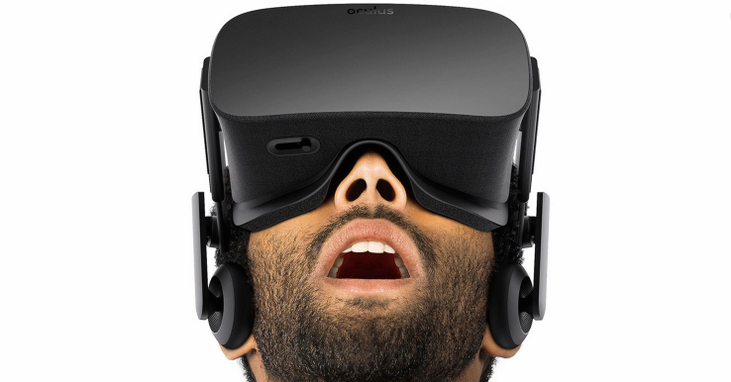
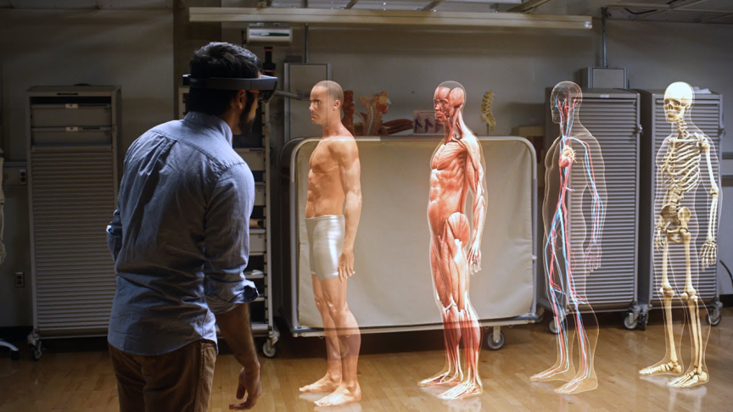
New Stereoscopic Displays
Head Mounted Stereoscopic Displays:
Oculus Rift
Sony PlayStation VR
HTC Vive
Samsung Gear VR
Microsoft HoloLens (AR)
Google Cardboard
2013-2016 AOL Inc.
2016 Microsoft
Notes:
All have been announced in the past five years

Slide 7
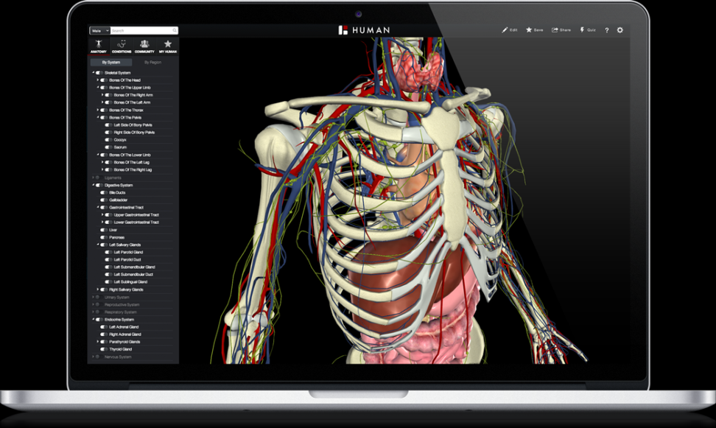
Current Work in the Field
There are solutions to the limited number of easily accessible 3D didactic tools in anatomical education.
ZygoteBodyTM
The BioDigital Human
Essential Anatomy
Cyber Anatomy
2016 BIODIGITAL, INC.
Notes:
Biodigital Human:
- Simulated anatomy and diseases. Animations of systems interactions. Free and can be run from the browser. Very in depth dataset.

Slide 8

Again, Why a 3D Virtual Anatomy Puzzle Game?
To create a 3D didactic tool for anatomy that:
Utilizes open source, high quality, anatomical models
Explores the utility of virtual reality in 3D visualization
Virtual

Slide 9




Platform Architecture
Software Platform
WorldViz Vizard Toolkit
Python
Dataset
BodyParts3D
Display Modalities
Traditional 2D Computer Monitor
Oculus Rift DK1/2
Input Devices
Keyboard Map
3DConnexion SpaceMouse

Slide 10
Proposed Game
The task of the user is to reconstruct 3D anatomical structures from a randomized bin of models.
Game Modes:
Interface Tutorial
Free Play Mode
Quiz Mode

Slide 11
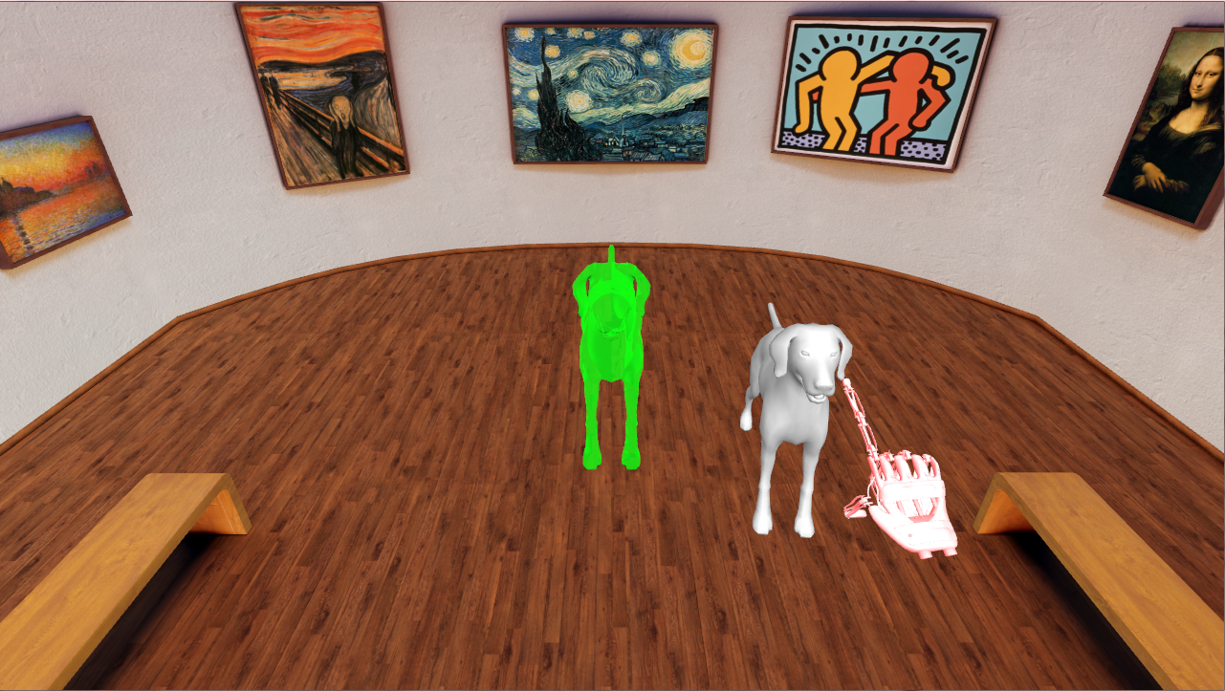
Interface Tutorial

Slide 12

Free Play/ Quiz Modes

Slide 13
Evaluation of Game
Procedure:
Subjects completed written fill-in-the-blank entrance exam to assess baseline knowledge.
Interface Tutorial was played 4 times with all combinations of input/display modality.
Anatomy puzzle game was played 3 times (using SpaceMouse and Oculus Rift)
1 play-through of desired anatomy in Free Play Mode
2 play-throughs of same desired anatomy in Quiz Mode
Another full factorial of input/display modalities in Interface Tutorial
Subjects completed the same fill-in-the-blank exit exam
Subjects completed comfort questionnaire

Slide 14
Evaluation of Game
Metrics Used to Quantify Performance:
Interface Tutorial
Average time per move
Quiz Mode
S_{total} = 10m₀ + 5m₁ + 2m₂ + 0m₃
S_{total} = Final Score
m_{n} = Total number of rounds with n failed attempts before successfully completing requested move
Metrics Used to Quantify and Qualify Comfort:
NASA-Task Load Index (TLX)

Slide 15
Goals of Evaluation
Quantify/Qualify the users’ comfort level with the interface and display technology
Quantify/Qualify the effect of training on input/display modalities, especially to those new to the hardware.
Quantify the effect of training associated with the Puzzle Game on the subject’s knowledgebase of tested anatomy

Slide 16


Results
2 subjects were tested
Both subjects were at the collegiate level
Neither subject had much experience with either the Oculus Rift or SpaceMouse
Neither subject had a background in Anatomy, or related fields
Both subjects were tested using the skull
Maximum score in Quiz Mode was 200 (20 objects)
Subject 1
Subject 2

Slide 17
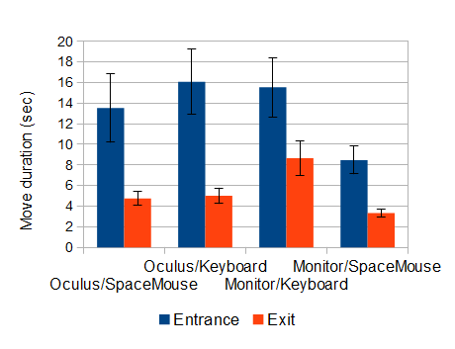
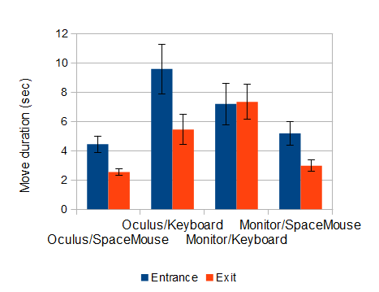
Results: Interface Tutorial
Subject 1
Subject 2

Slide 18
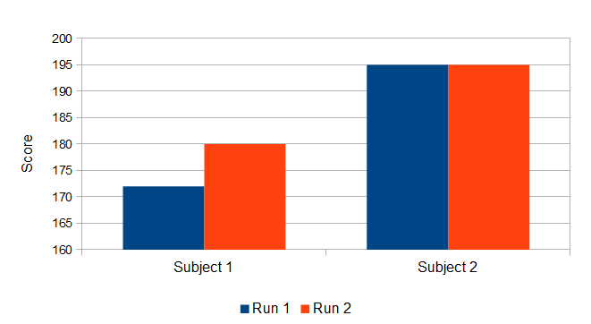
Results: Quiz Scores

Slide 19
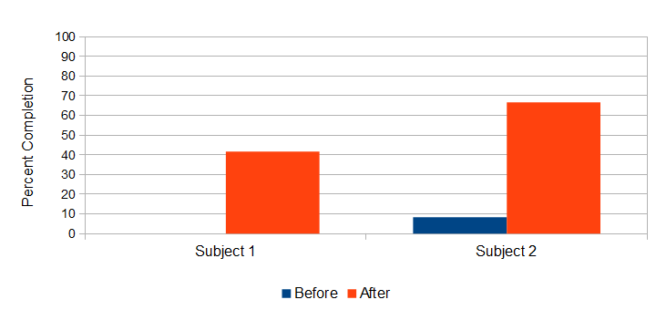
Results: Written Exam

Slide 20
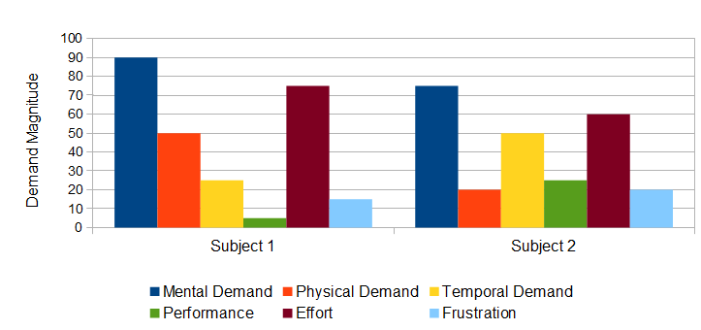
Results: Comfort Level (NASA TLX)

Slide 21

Conclusions
Subjects were able to learn using our prototype.
Both subjects rated their experience with high Mental Demand and Effort.
Both subjects preformed much better with each input/display combination at the end of the test.

Slide 22
Future Work
Expand the study
More subjects
Include more standardized measurements and evaluations
Fitt’s Law
Expand usable portion of the dataset
Migrate to new platform (ie. Unity)
Revisit game mechanics
Subjects reported slight discomfort when playing the game with the Oculus because of the mechanics.
Outreach program
Work with students in K-12 to stimulate interest in anatomy, bio-engineering, medical imaging, game development, etc.

Slide 23











Acknowledgements
Biomedical Modeling, Visualization & Image-guided Navigation Group
Funding Support
Alex Bensch
Aditya Daryanani
Dylan Dang
Shusil Dangi
Alex Dawson-Elli
Mia Garbaccio
Kevin Alexandre
Amy Hughes
Michael Kormos
Michael Potter
Caroline Trier
Zhenlin Xu
Kenneth la Marca
Nathan Burrell
Collaborators

Slide 24
Thank You!
Erik MESSIER ^{a,1}, Jascha WILCOX ª, Gabriel DIAZ ^{b}, and Cristian A. LINTE ^{a,b}
ªKate Gleason College of Engineering, ^{b}Chester F. Carlson Center for Imaging Science, Rochester Institute of Technology, Rochester, NY, USA
2016 Medicine Meets Virtual Reality
Las Angeles CA USA

Slide 25
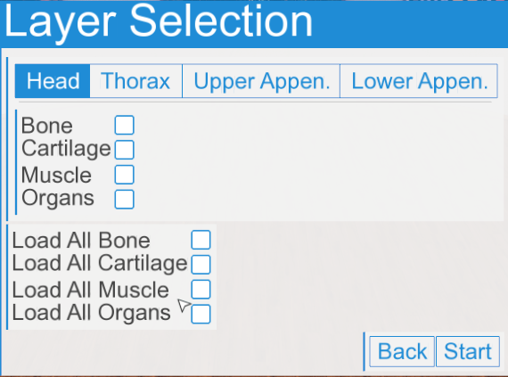
Since the Study Was Performed

Slide 26
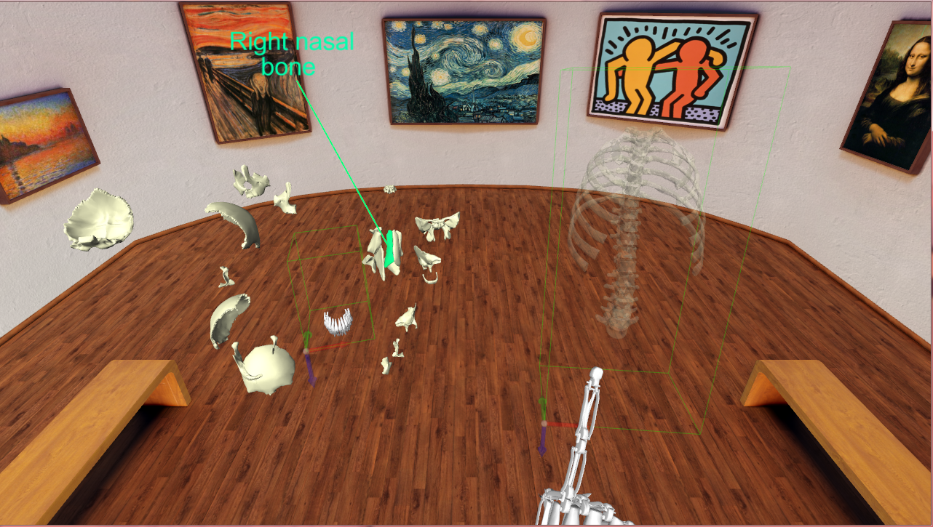
Since the Study Was Performed

Slide 27
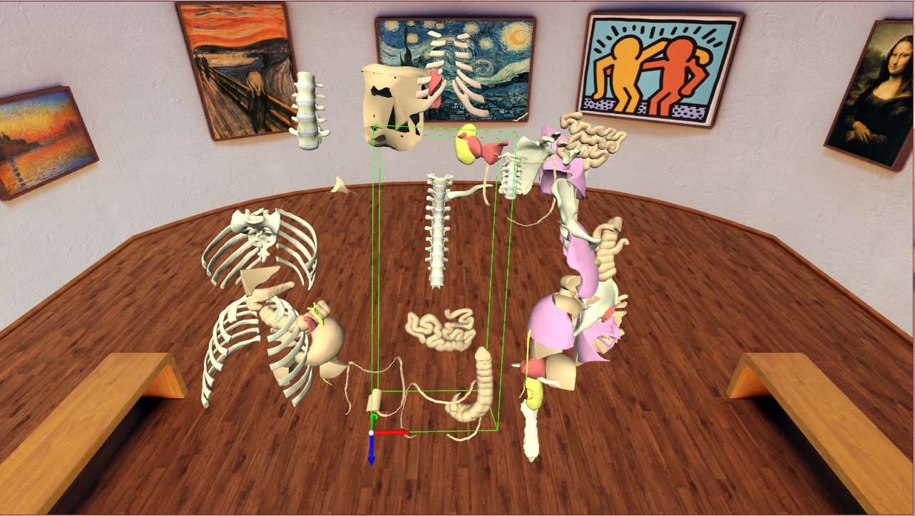
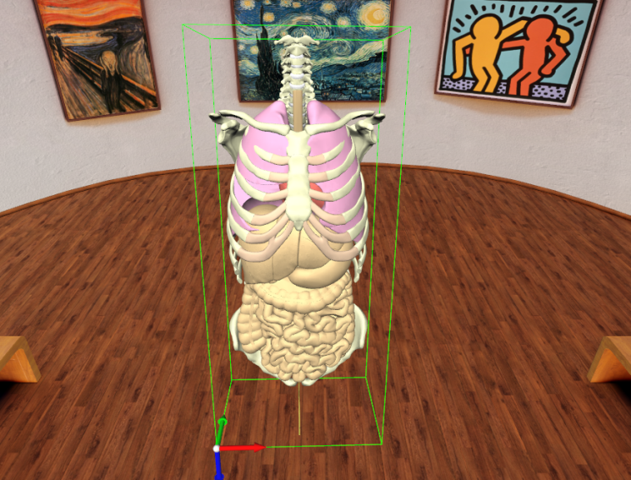
Since the Study Was Performed

